Slide 1
CS 106A, Lecture 1
Welcome to the course!
required reading:
General Information handout
suggested reading:
Karel, Ch. 1-2
This document is copyright (C) Stanford Computer Science and Marty Stepp, licensed under Creative Commons Attribution 2.5 License. All rights reserved.
Based on slides created by Nick Troccoli, Chris Piech, Keith Schwarz, Mehran Sahami, Eric Roberts, Stuart Reges, and others.

Slide 2

Plan For Today
Introduction
Course Policies
Meet Karel the Robot

Slide 3
Plan For Today
Introduction
Course Policies
Meet Karel the Robot

Slide 4
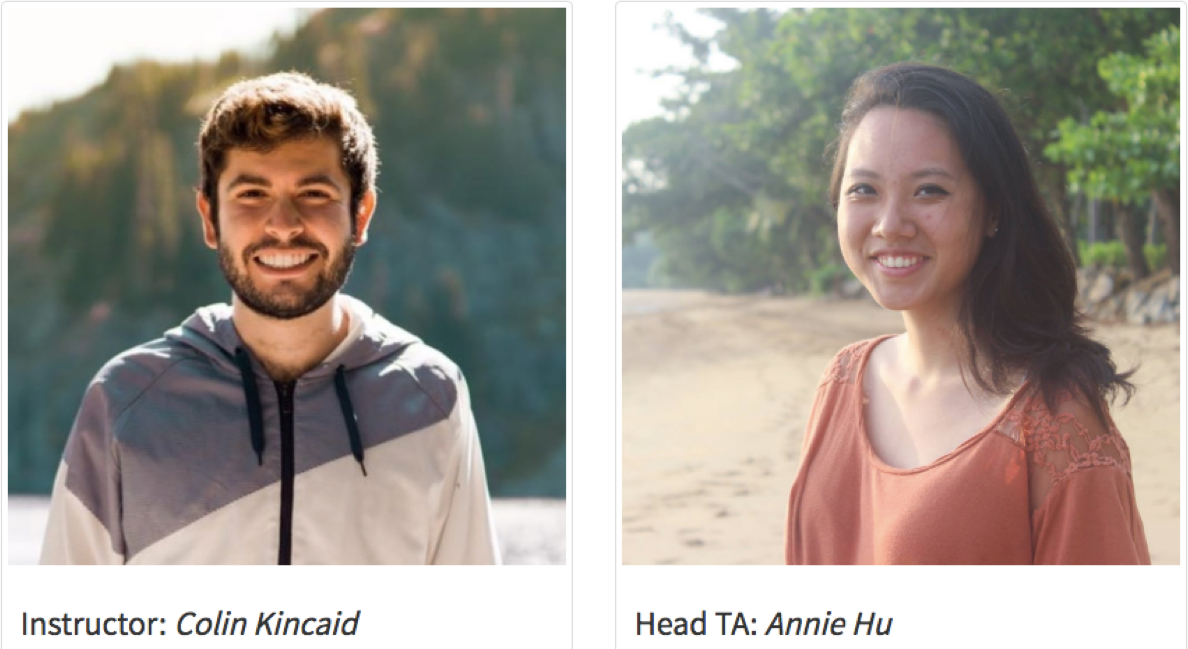
Nice to meet you!

Slide 5
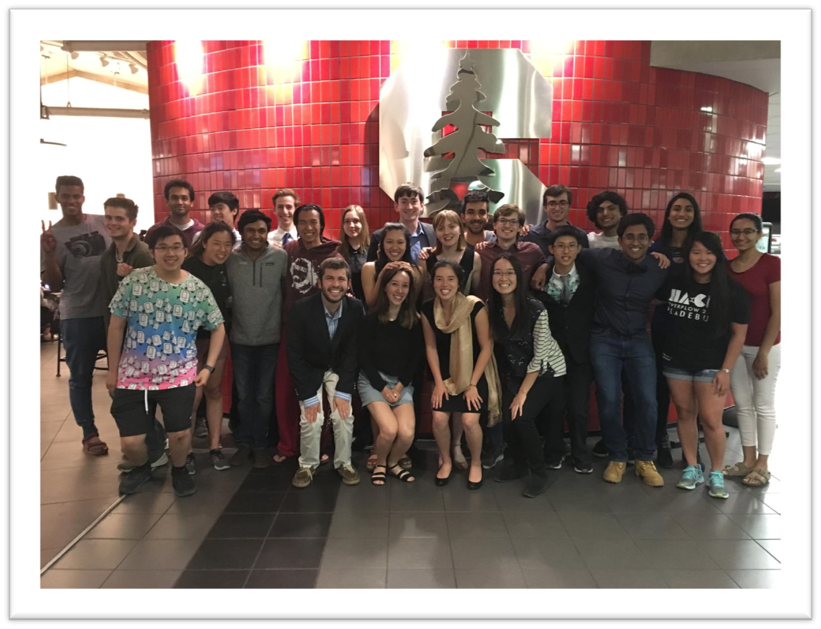
Section Leaders
Helpful undergraduate assistants who will:
run your discussion section each week
grade your homework assignments and exams
help you when you have questions
... and much more

Slide 6
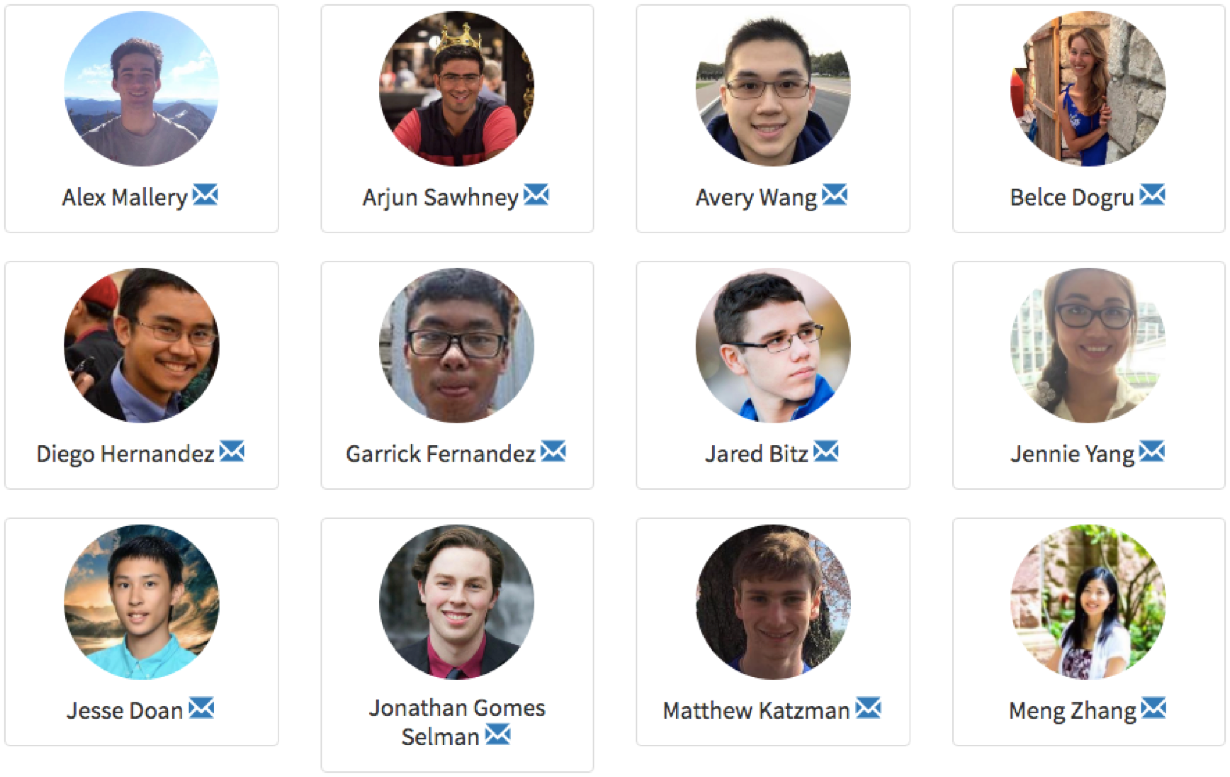
Nice to meet you!

Slide 7
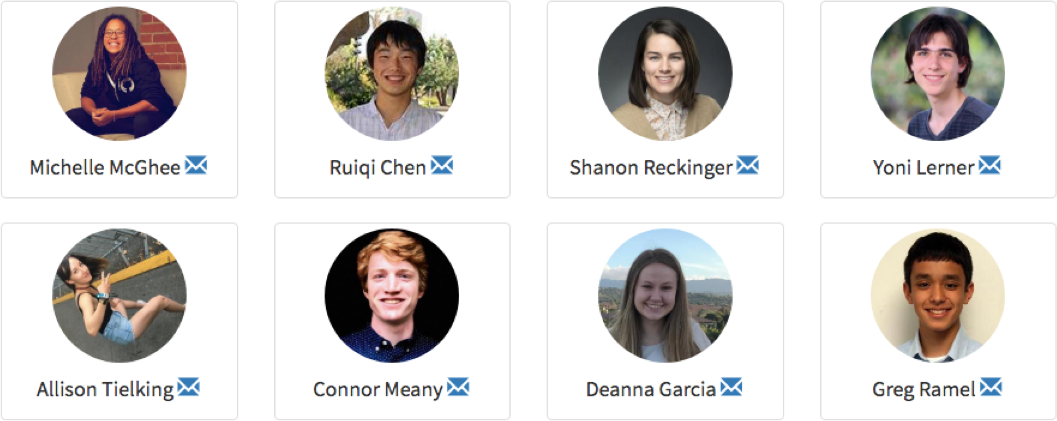
Nice to meet you!

Slide 8
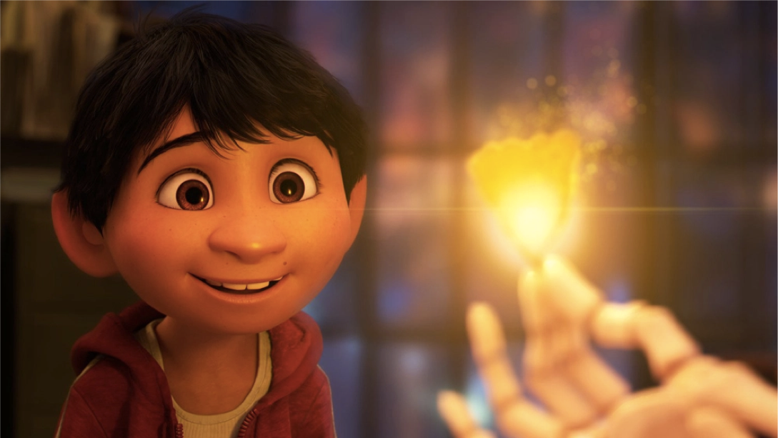
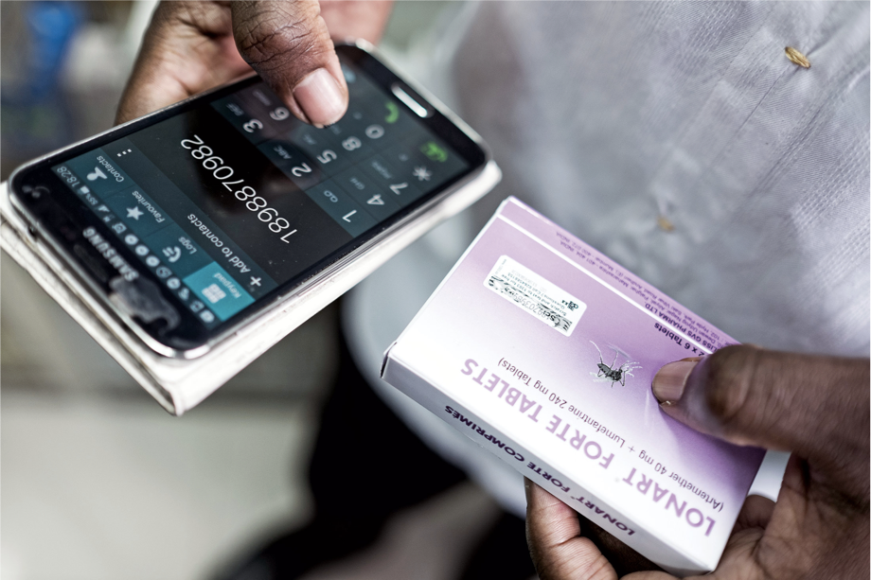
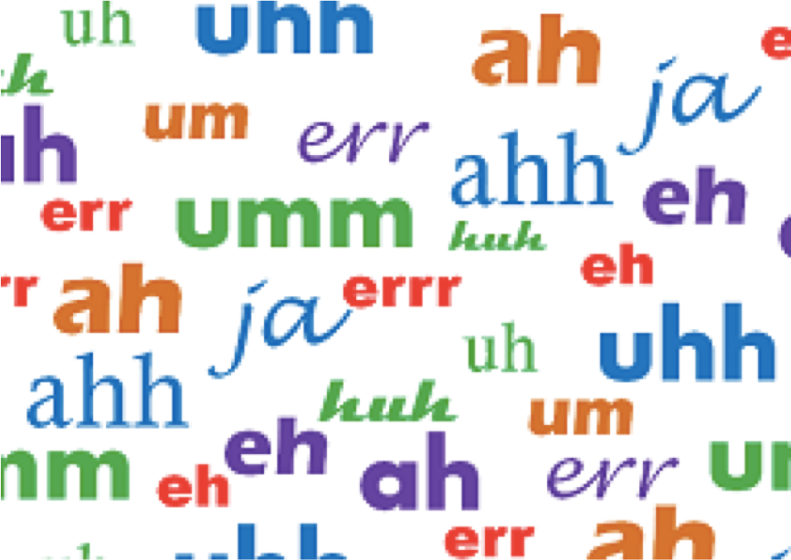
What is Computer Science?
The art of using computing to solve complex problems.
– Specify instructions that computers execute, usually in a
programming language
Applicable to art, medicine, linguistics, and more
Touches many aspects of our daily lives

Slide 9
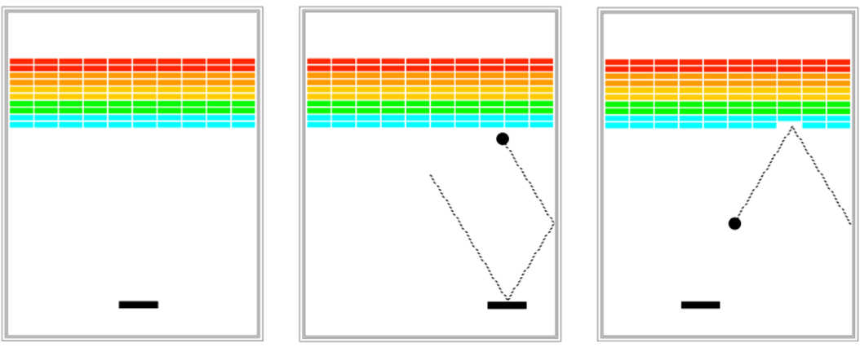

What is CS 106A?
Programming Methodology
“A system of methods used in a particular area of study or activity”
Focusing on computational problem solving, not Java syntax
No prior programming experience required!
Topics include:
Karel the Robot
Text-based programs
Graphics and animation
Games
And more…

Slide 10
Is 106A the right fit for you?
General topics we will cover:
variables
control flow (loops and conditionals)
functions or methods (including parameters and return statements)
classes and objects
arrays
console and file I/O
If those things are familiar to you, consider CS106B!
If you know lots and still take this class, great! Just be mindful of everyone else

Slide 11
Time-out: Think, Pair, Share
What is one of your core values?
Optionally: How might you use computing in pursuit of that value?
If you feel comfortable: Share with a neighbor!

Slide 12
Plan For Today
Introduction
Course Policies
Meet Karel the Robot

Slide 13
Course Website
cs106a.stanford.edu

Slide 14

Units
Stanford grad student?
No
Yes

Slide 15


Textbooks
Karel the Robot Learns Java, coursereader (35 pages)
used this week and next week as we introduce coding
refer to this coursereader for Java features you are allowed to use on the first assignment
free PDF available online
The Art & Science of Java, by Eric Roberts
written here at Stanford; tailored to this course; a valuable reference
available on reserve at library

Slide 16
Grading
****** | 45% | Programming assignments
* | 10% | Section participation and lecture feedback
** | 15% | Midterm Exam
**** | 30% | Final Exam

Slide 17
Grading
****** | 45% | Programming assignments
* | 10% | Section participation and
 |  | lecture feedback
** | 15% | Midterm Exam
**** | 30% | Final Exam

Slide 18
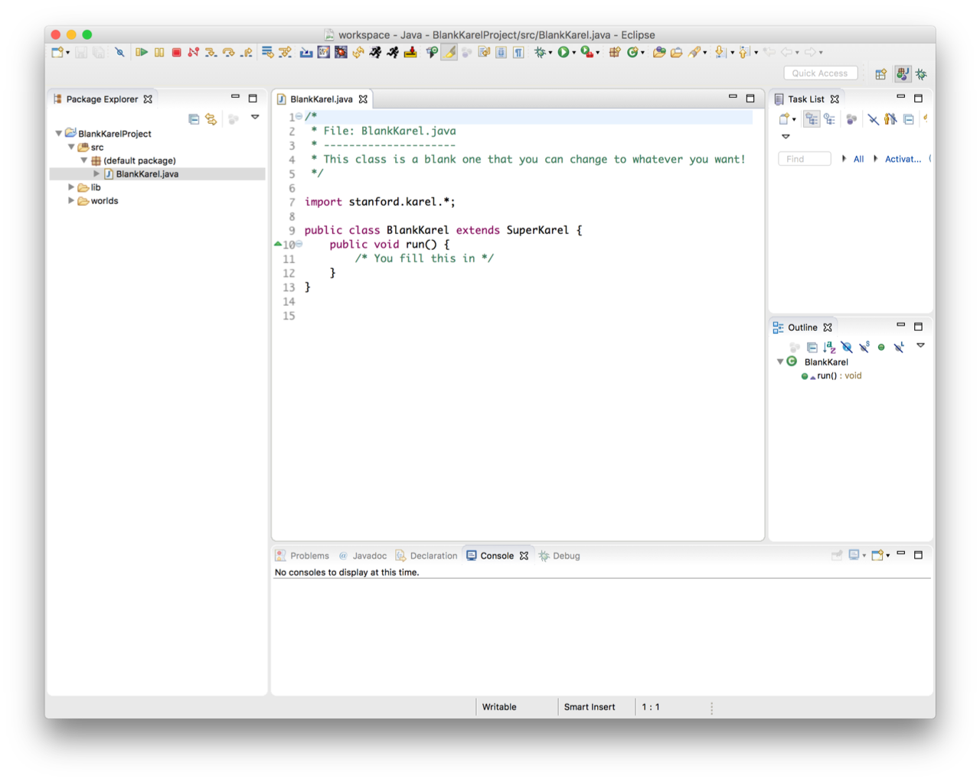
Programming Assignments
6 programming assignments (some individual, some in pairs), completed using Eclipse
free software, available on course website
homework: set up Eclipse!
come to LaIR this Tuesday 7-9PM for troubleshooting
Graded on functionality (behavior) and style (elegance)
you’ll get lots of feedback on each from your section leader
grading scale is divided into "buckets”

Slide 19
The Bucket System
√ | Satisfactory; meets requirements, maybe a few issues

Slide 20
The Bucket System
√+ | Well done; satisfies all assignment requirements
√ | Satisfactory; meets requirements, maybe a few issues

Slide 21
The Bucket System
√+ | Well done; satisfies all assignment requirements
√ | Satisfactory; meets requirements, maybe a few issues
√- | Problems serious enough to fall short of assignment requirements

Slide 22
The Bucket System
+ | Exceeds expectations; often reflects additional work
√+ | Well done; satisfies all assignment requirements
√ | Satisfactory; meets requirements, maybe a few issues
√- | Problems serious enough to fall short of assignment requirements

Slide 23
The Bucket System
+ | Exceeds expectations; often reflects additional work
√+ | Well done; satisfies all assignment requirements
√ | Satisfactory; meets requirements, maybe a few issues
√- | Problems serious enough to fall short of assignment requirements
- | Extremely serious problems, incomplete effort or understanding

Slide 24
The Bucket System
++ | Absolutely fantastic submission (very rare)
+ | Exceeds expectations; often reflects additional work
√+ | Well done; satisfies all assignment requirements
√ | Satisfactory; meets requirements, maybe a few issues
√- | Problems serious enough to fall short of assignment requirements
- | Extremely serious problems, incomplete effort or understanding

Slide 25
The Bucket System
++ | Absolutely fantastic submission (very rare)
+ | Exceeds expectations; often reflects additional work
√+ | Well done; satisfies all assignment requirements
√ | Satisfactory; meets requirements, maybe a few issues
√- | Problems serious enough to fall short of assignment requirements
- | Extremely serious problems, incomplete effort or understanding
-- | Little effort

Slide 26
The Bucket System
++ | Absolutely fantastic submission (very rare)
+ | Exceeds expectations; often reflects additional work
√+ | Well done; satisfies all assignment requirements
√ | Satisfactory; meets requirements, maybe a few issues
√- | Problems serious enough to fall short of assignment requirements
- | Extremely serious problems, incomplete effort or understanding
-- | Little effort
0 | No submission

Slide 27
Getting Help
Visit the SLs in the LaIR (1st floor of Tressider Union)
open Sun-Wed, 7PM – 11PM, starting this Wednesday
staffed with multiple section leaders to answer questions
use the CLaIR (Conceptual LaIR) queue for course material questions
other help resources:
instructor office hours
head TA office hours
email SL, TA, instructor
Eclipse troubleshooting session Tuesday 6/26 7-9PM @ LaIR

Slide 28
2 Minds are Better Than 1
Some assignments may optionally be done in pairs
Both partners receive the same grade
A chance to brainstorm ideas and work with another programmer
MUST be in the same section!
– put the same section preferences to make this happen!
More info in handout #1 and on the course website

Slide 29
Late Days
Start out with 3 “free late days”: each late day allows you to submit an assignment 24 hours late without penalty.
Hard deadline 48 hours after original due date
1-bucket deduction per day late after late days are exhausted
Pair late days are assessed individually
“Pre-granted extensions” – additional extensions granted only in
very special circumstances. Head TA must approve extensions.

Slide 30
Grading
****** | 45% | Programming assignments
* | 10% | Section participation and lecture feedback
** | 15% | Midterm Exam
**** | 30% | Final Exam

Slide 31
Discussion Sections
Weekly 50-minute sections led by your section leader
Go over lecture material, do practice problems, answer questions
Graded on section attendance + participation
Homework: sign up for section on the course website!

Slide 32
Lecture Feedback
Give me feedback so that I can do better!
Anonymous, and you get credit no matter what you write
– unless it is inappropriate
Give feedback by the Monday after your assigned lecture
More instructions on the website under “Lectures”
Homework: figure out which lectures you are assigned for giving feedback

Slide 33
Grading
****** | 45% | Programming assignments
* | 10% | Section participation and
 |  | lecture feedback
** | 15% | Midterm Exam
**** | 30% | Final Exam

Slide 34
Exams
Midterm exam – Monday, July 23rd, 7-9PM
Fill out the head TA’s exam form by July 9 if you have an academic or University conflict or OAE accommodations
Final exam – Friday, August 17th, 12:15-3:15PM
No alternate final! You MUST be able to take the final exam at the scheduled time (except for OAE accommodations)
On both exams, you will be allowed two double-sided “cheat sheets”: handwritten or typed notes that you think will be helpful.
You will also be provided Java syntax reference sheets

Slide 35
Grading
****** | 45% | Programming assignments
* | 10% | Section participation and lecture feedback
** | 15% | Midterm Exam
**** | 30% | Final Exam

Slide 36
Stanford Honor Code
The Honor Code is an undertaking of the students, individually and collectively:
that they will not give or receive aid in examinations; that they will not give or receive unpermitted aid in class work, in the preparation of reports, or in any other work that is to be used by the instructor as the basis of grading;
that they will do their share and take an active part in seeing to it that others as well as themselves uphold the spirit and letter of the Honor Code.
The faculty on its part manifests its confidence in the honor of its students by refraining from proctoring examinations and from taking unusual and unreasonable precautions to prevent the forms of dishonesty mentioned above. The faculty will also avoid, as far as practicable, academic procedures that create temptations to violate the Honor Code.
While the faculty alone has the right and obligation to set academic requirements, the students and faculty will work together to establish optimal conditions for honorable academic work.
see also: http://cs106a.stanford.edu/handouts/2-Honor-Code.pdf and http://honorcode.stanford.edu/

Slide 37
Honor Code and CS 106A
Please help us ensure academic integrity:
indicate any assistance received on HW (books, web sites, friends).
do not look at other people's solution code (outside of your pair).
do not give your solution code to others, or post it on the web.
report any inappropriate activity you see performed by others.
Assignments are checked regularly for similarity with help of software tools.
If you realize that you have made a mistake, you may retract your submission to any assignment at any time, no questions asked.
If you need help, please contact us and we will help you.
we do not want you to feel any pressure to violate the Honor Code in order to succeed in this course.

Slide 38
Plan For Today
Introduction
Course Policies
Meet Karel the Robot

Slide 39

Meet Karel the Robot!

Slide 40
Meet Karel the Robot!
Hello, world!

Slide 41
Karel's World
. | . | . | . | . . .
. | . | . .
. | . | . | .
3
2
1
1
2
3
4
5

Slide 42

Karel's World
. | . | . | . | . . .
. | . | . .
 | . | . | .
3
2
1
.
1
2
3
4
5

Slide 43
Karel's World
. . . . .
3
. . . . .
He.llo, world!. .
2
.
.
1
1
2
3
4
5

Slide 44

Karel's World
. | . | . | . | . . .
. | . | . .
 | . | . | .
3
2
1
.
1
2
3
4
5

Slide 45

Streets (rows)
. | . | . | . | . . .
. | . | . .
 | . | . | .
3
2
1
.
Each row is called a street.
1
2
3
4
5

Slide 46
Avenues (columns)
. | . | . | . | . . .
. | . | . .
 | . | . | .
3
2
1
.
1
2
3
4
5
Each column is called an avenue.

Slide 47
Corners (locations)
. . . . .
. . . . .
. . . .
3
2
.
1
The intersection of a street and an avenue is a corner.
1
2
3
4
5

Slide 48
Walls
. | . | . | . | . . .
. | . | . .
 | . | . | .
3
2
1
.
1
2
3
4
5
Karel cannot move through walls.

Slide 49
Beepers
. | . | . | . | . . .
. | . | . .
 | . | . | .
3
2
.
1
Beepers mark locations in Karel's world. Karel can pick them up and put them down.
1
2
3
4
5

Slide 50
Wrap-up
Introduction √
Course Policies √
Meet Karel the Robot
√
Next time: more programming with Karel!

